Slide 1
What the Internet offers (that we don’t want to break) and what more can we give them (that they want)
Report of the “User Group”
Sara Kiesler
Laura Dabbish
Colleen Stuart
Ruogu Kang
Peter Kinnard
Akshay Udiavar
Larry Peng Zhang
Neo Zhe Han
November, 2011

Slide 2
What the Internet offers individuals uniquely
Communication and access to information – since the Internet began
Creating and distributing your own content
Anonymity (or privacy) – People don’t understand it but they want it
Social transparency – a growing capability
Social transparency is the visibility of people’s actions on public or shared artifacts
The pattern of information exchange among people
Notes:
Our aim is to better understand the unique value people get from the internet
- we're concern with investigating how xia won't break current things that people do, and perhaps enable new things
- figure out what users care about, so that xia doesn't break it.
- what is the internet giving people that they really value - things that they don't give others in everyday life

Slide 3
Research
Anonymity
- What people want and how they understand anonymity on the Internet
Transparency
- Transparency and collaboration in GitHub
A future vision of applications
- Visualizations of Mech Turk Workflow (poster)
The future of work and collaboration online
- Visioning XIA routing (poster)
Not today: Feedback loop to increase security behavior
- Collaboration with security group - TBA

Slide 4
Perceptions about Anonymity on the Internet
Ruogu Kang, Sara Kiesler
Peter Kinnaird, Colleen Stuart, Laura Dabbish
November 10th, 2011

Slide 5
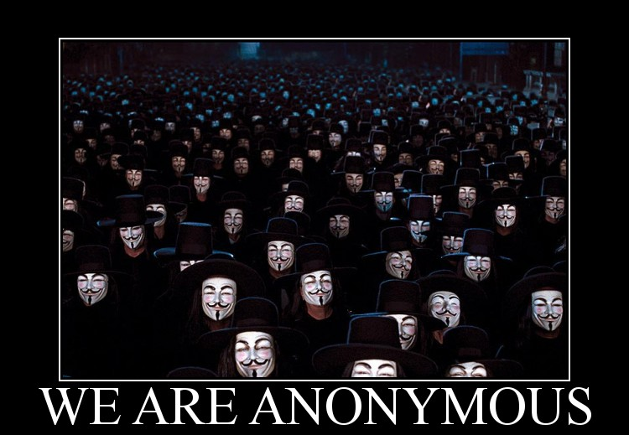
Who wants to be anonymous?
Is it just evil people?
Terrorists?
The afflicted?
Deviants?
All of us?
HOW do we do it?
Notes:
We also know that Internet changed the way we communicate with other people drastically. One major distinction is that internet enables us to be anonymous online. Existing study has not provided a complete answer about who wants to be anonymous, and what do people do when they are anonymous. Is it just only for evil purposes conducted by terrorists? Or people who are afflicted or deviants and need a place to express themselves freely without being judged by their friends and family? Or is it possible that all of us may have the desire to be anonymous under some circumstances?
The purpose of our study is to understand Internet users’ understanding about anonymity on Internet, and what methods they are using to achieve anonymity.

Slide 6
Method
Semi-structured interviews (1 hour)
34 participants
17 female, 17 male
Recruited from Mechanical Turk, Craigslist, university postings
15 American, 14 Chinese, 1 Ethiopian, 1 Romanian, 1 Greek, 1 Philippine, 1 British
Lots of stories
A Romanian once abducted
A 4chan subscriber with multiple personas
A Chinese anonymous shopper
A victim of domestic violence
Notes:
We conducted 34 interviews with participants from all over the world. People are recruited from… 15 of them are American, 14 are Chinese Internet users, and several people from other countries. Almost half of our participants are students, but we also have a variety of people with different level of technical skills. IT manager been more than 10 years, and a person who had a degree in network security.
WE’ve collected a lot of interesting stories from these interviewees and today I’m going to share a few of them with you, including a romanian woman once abducted to foreign country by signing up for a fake online job, an experienced 4chan user with multiple personas, a Chinese student who always use fake name to do online shopping in China, and a victim of domestic violence who seeks for help from online forums. This presentation will cover some samples of our result to give you a brief idea of the huge range of people and reasons for being anonymous, but definitely not a comprehensive list.
Some of it is good, some bad, some funny, some very serious. If you only think of one type of anonymity or one type of person, then you aren't designing for everyone else.

Slide 7
Anonymous activities
Sending out data
Participating in forums
Posting reviews/comments/harsh critiques
4chan, domestic violence
Attacking/spoofing others, trick friends
Anonymous emailing (to report incorrect behavior)
Torrenting and file sharing
Transferring data (encrypted email, work to publish)
Browsing info
Searching for information on sensitive topics
Browsing friends’ blogs, hacking or subversive websites
Social
Using fake information on Facebook/Twitter, craigslist, online dating sites, online chat, online games, online job, online shopping
Notes:
I asked interviewees what they did anonymous online. We have got three major categories. First one is proactively sending out data, like posting comment on forums, attacking others, sending out email or files to other person, and sharing files online. One experienced 4chan user who has 7? personas, and trying to cultivate different skill sets on each of the personas. [need check] A woman who experienced domestic violence before strongly tried to protect her anonymity when she goes on the forums because she is afraid “﻿ I wanted to be anonymous, because I was afraid if he seen any my postings that he would hurt me.”
Second type of activity is just browsing information. Some users said they want their search history to be private when they search for senstivie topics, and some reported using proxy servers when just browsing hacking websites, because they don’t want government to track on them and think they are suspicious individuals.
The other type is mostly using fake identity on social networking sites or in other methods of communciating with others. One Chinese user reported using fake name in online shopping, for two reasons: don’t want to be attacked by the sellers online because it happened before that seller would expose personal information of buyers to public because the buyers gave them bad reviews.

Slide 8
Why anonymity?
Reason | Example | Who?
Protect oneself | Avoid being attacked/stalked Avoid harassment (calls/spam/trolling) | All participants
Scared of information exposed | “Can’t control who accesses my data” Data stored on Internet permanently Hide from friends/people they know | All participants
Political and legality reason | Afraid of government Internet blocking Avoid legal issue | All participants Ethiopian, Chinese, Greek When filesharing/torrenting
Unknown fear | “﻿My insight is that usually people’s ideas of who may harm them are amorphous.” | All participants
Some communities have an anonymity norm |  | All participants
Feel free to say anything |  | All participants
For fun |  | Chinese
Notes:
From those examples, we could see that there are lots f reasons that drives user to be anonymous. We summarized some major reasons in this table. And some of them are specific to some countries. Two most common reasons are that – protect one’s safety, and people’s fear about information exposed.
Another interesting thing to note is that a lot fo people expressed that they actually do not have a specific target in mind that who they are afraid of, but it’s more of a general fear and unknown preparation.

Slide 9


Hide from whom?
User
App
THE INTERNET
Edge network
Edge network
2.
Google, Facebook, forums…
Edge network
App
1.
Proxy server
3.
Other users
4. Government
5. Hackers/Criminal groups
Notes:
If we map users concerns about online anonymity to an abstract structure of the internet, our findings suggest that majority of the users have the desire to be anonymous from other user. for example they don’t want to be judged by friends and family because of some special interest or vulnerable experiences, so they want to hide the content they posted or the traces that they have been on some websites. they don’t want future employers have access to personal history or bad records, and they don’t like the feeling that they have no control about who will access their data.
Secondly, some users reported concern about companies may misuse their information, send spams to them, or they don’t like big companies selling ads to them.
Further, more advanced users who uses web proxy to hide their identity, expressed some concern that the owner of proxy servers. –”﻿I don’t even use any email or password to those proxy servers, because they can log those passwords and user names and use it for their own if they want to. I don’t fully trust the proxy servers. I use it only to access those websites. Other than that, I use direct connection or the site owners.” Similar to this, one user also mentioned that he is aware that bit torrent client will track his activity,
Other than these three categories, participants also reported fear that government might be monitoring their activity, and hackers might hack their computer to get their information.

Slide 10
What are users currently doing to achieve anonymity?
Non-technical
Fake identity
Personas
Fake location
Limit information conveyed online
Not participating (not posting)
Browse without log in
Use multiple email accounts to register
Different communication pattern
Use random pseudonym
Relevant to technical
Encrypt email message
Use proxy server/self-built server
Use Tor
Use dynamic IP
Use VPN
Manually change IP address
Change Internet Service Provider regularly
Clear browser history and cookie
Use Google encrypted search
4chan

Slide 11

User
App
Edge network
THE INTERNET
Edge network
Edge network
App
Proxy server
Other users
Notes:
Most manipulations people currently doing is on their own browser, or ISP. And control the way they interact with users, or select different proxy server to hide their IP.

Slide 12
Case study
Romanian woman
Anonymous activity: online jobs
Involved in a criminal event
After the accident, she uses false information on every site till she thinks the site is trustworthy(e.g., no spam, big company).
“﻿My life was in danger… I was even afraid to go on the Internet at that time. But it was a good experience because I learned a lot of things about the Internet, and the most important, you don’t have to use real information about yourself.”
Notes:
At this point I’d like to introduce a story about a woman in Romanian who were once abducted by malicious group through fake online job contract. She provided all her real information to the online job provider and actually went to another country but found out it was totally a criminal group. At the same time her computer was hacked and all her personal information was stolen. Because of this experience she starts to learn more about computer and network security, and start to use all fake information to protect her own safety.
Most people are preparing for unknown fear, but we do have people who use anonymity to protect themselves from malicious group. Technical, or policy implication.

Slide 13
Self-evaluation of anonymity level
15 participants agreed they were totally unidentifiable to the rest of the world (when they use a random ID or fake identity, etc.).
23 participants thought some users on the site (s), or their friend or moderators know their identity on the website (s).
7 participants thought someone outside the community can find out their identity, or there is no anonymity on the Internet.
“﻿Everything is extremely traceable nowadays.”
“﻿Just as I know nothing can be locked down and protected online.”

Slide 14
What do people want?
Anonymous
Benefit:
Free to say anything
Protect personal information and safety
Don’t worry about being judged/searchable/bad consequences
Easy to quit the community
Cost:
Hard to build reputation
Hard to build trust (don’t know audience)
Hard to start relationship/connection
Irresponsible behavior
Low participation
Extra effort to manage
Psychological bad feeling
Real name
Benefit:
Build trust
Connect to people
Control irresponsible behavior and rumor spreading
Recognizable
Consistent with real life
Get better recommendation
Cost:
Bad things tie to you
Information exposed to unknown audience
Get spam
Threaten to computer and personal security
Not free to say anything
Offend others
Found by people you don’t like
Notes:
People definitely want anonymous – quite a few participants mention that they are almost always anonymous when they go online.

Slide 15
Summary
Users’ perception about anonymity on Internet:
Implication for the future Internet:
Make it easier to be anonymous?
More transparent?
What to hide | Hide from whom
Posting to the public One to one communication Downloading/uploading files Browsing/connection trace | Other users (government/hackers) Destination application (companies)
Notes:
People definitely want anonymous – quite a few participants mention that they are almost always anonymous when they go online.

